Slide 1
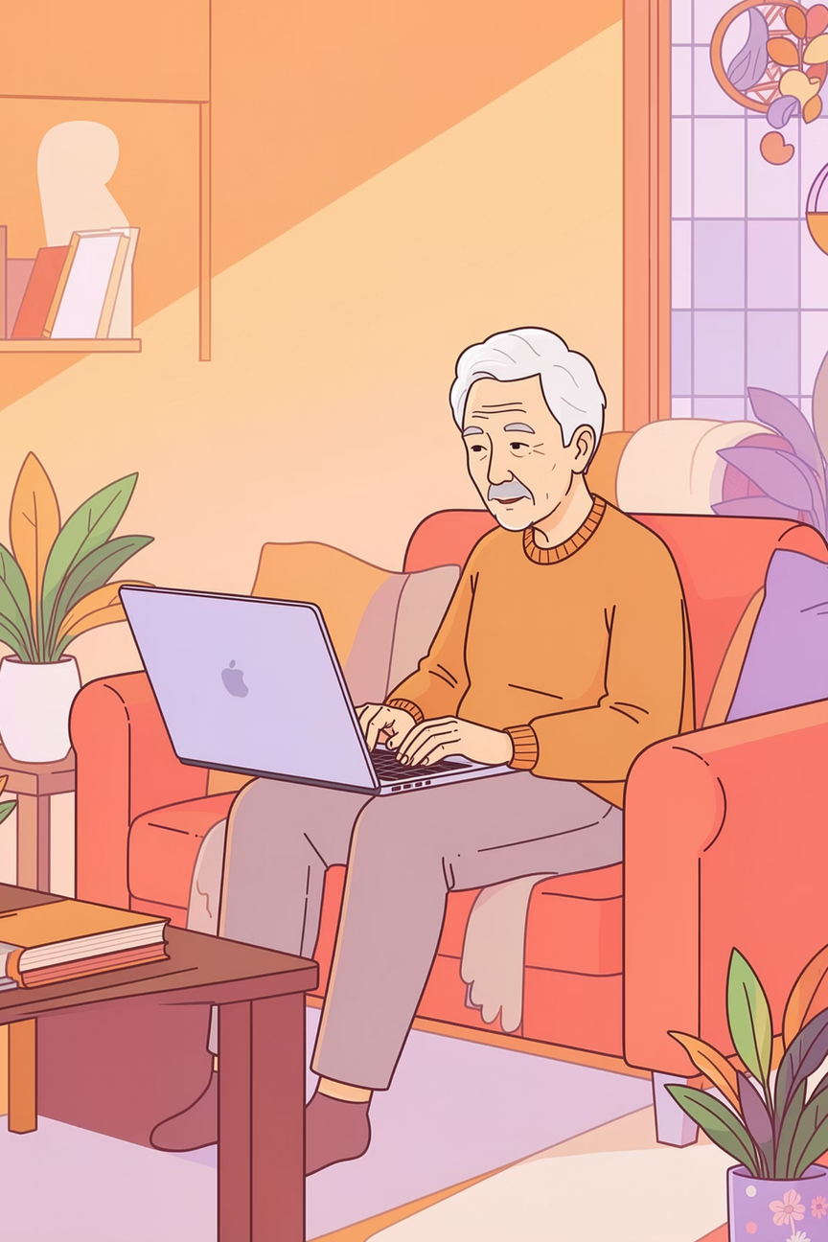

Email Simulation Game
PHISHING AWARENESS
AGES 50 & ABOVE
An educational cyber-safety game designed specifically for older adults who use email, online banking, and shopping websites — helping you stay safe online with confidence.
Notes:
1

Slide 2
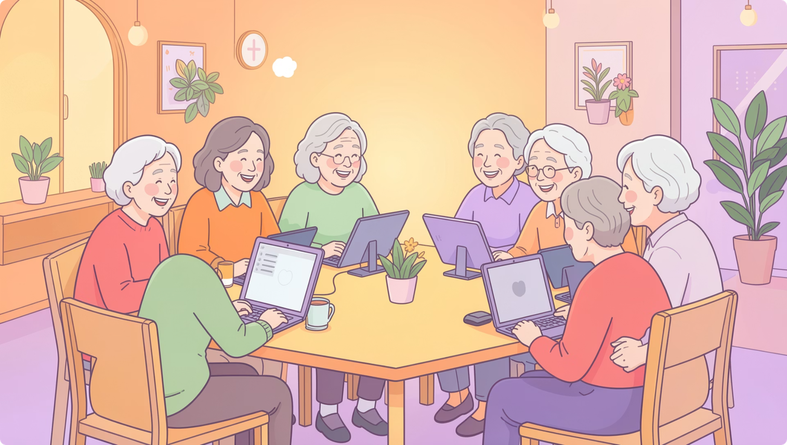
Who Is This Game For?
This game is designed for adults aged 50 and above who use everyday internet services — but may not have received formal cyber-safety training.
🏠 Home Internet Users
🏦 Online Banking Users
📧 Email Users
🛒 Online Shoppers
Notes:
2

Slide 3
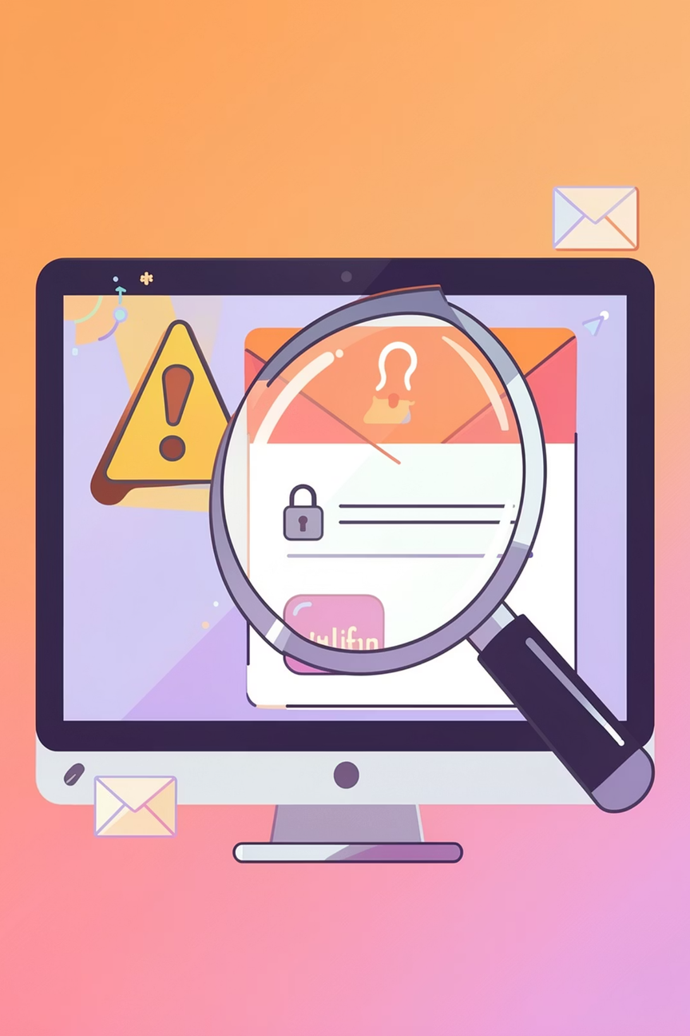
What You Will Learn
The game teaches you to recognise the warning signs of a phishing attack — emails designed to trick you into giving away personal information.
Fake Sender Addresses
Spot when an email claims to be from your bank but isn't.
Urgent or Threatening Language
Recognise pressure tactics used to make you act quickly.
Suspicious Links
Identify dangerous links before you click them.
Spoofed Organisations
See how criminals pretend to be banks, delivery firms, or government bodies.
Notes:
3

Slide 4
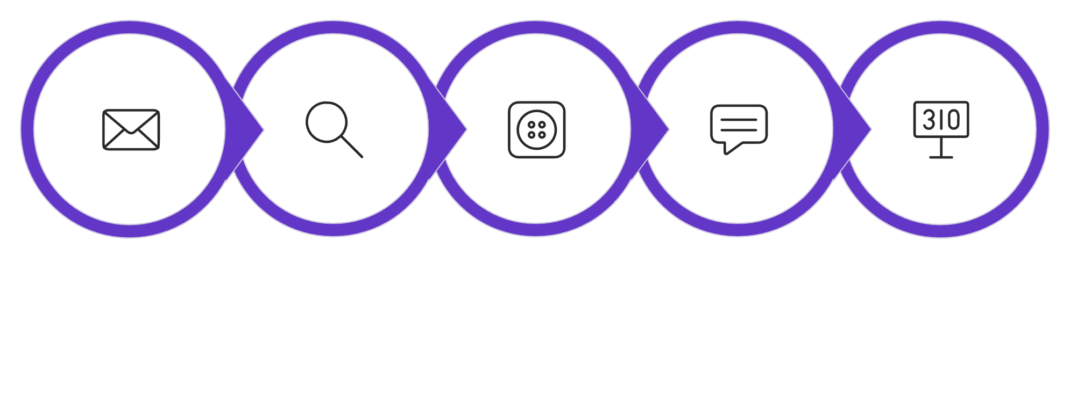





How the Game Works
See Explanation
Score Update
Read Email
Find Clues
Choose
Each round walks you through a realistic email scenario. There is no time pressure — take as long as you need to inspect the details and make a safe decision.
Notes:
4

Slide 5
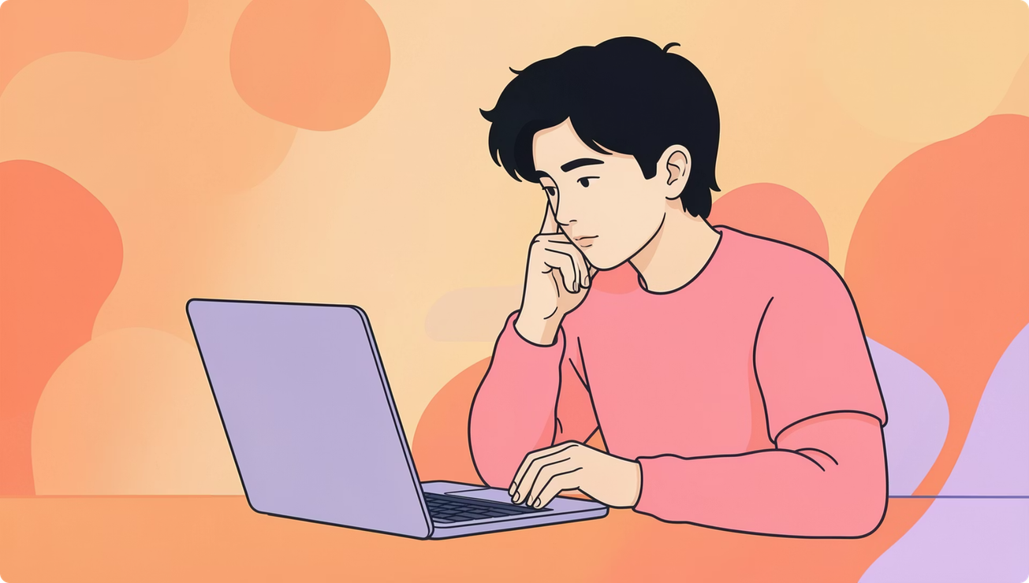

You Are in Control
When a suspicious email appears, you decide what to do. The game trains you to pause and think before reacting — exactly the skill you need in real life.
Click the link
Delete the email
Report the message
Only if you are certain it is safe.
When something feels wrong or unclear.
Flag suspicious emails to help protect others.
Notes:
5

Slide 6



Friendly Feedback Every Step of the Way
Every answer — right or wrong — comes with a clear, plain-English explanation. The goal is to teach, not to punish.
✅ Correct choice: "Great job! The sender address is suspicious, and the message creates unnecessary urgency."
❌ Incorrect choice: "This email is unsafe — legitimate banks never ask for passwords through email links."
Notes:
6

Slide 7
Your Progress & Passing Score
70%
3+
5
Minimum Pass Mark
Warning Signs Spotted
Steps Per Round
You need to correctly identify phishing warning signs in at least 70% of scenarios.
Each round challenges you to find at least three clues that an email is suspicious.
A simple, repeatable process that builds confidence with every attempt.
At the end of each round, you receive a score, a summary of any missed clues, and practical safety reminders to carry into real life.
Notes:
7

Slide 8




Key Features Designed for You
Large Clear Text
Colour-Coded Clues
Easy to read at any screen size — no squinting required.
Warning signs are visually highlighted so nothing is missed.
Plain English Tips
Replay Anytime
No complicated cybersecurity jargon — ever.
Practice as often as you like to build lasting confidence.
Notes:
8

Slide 9
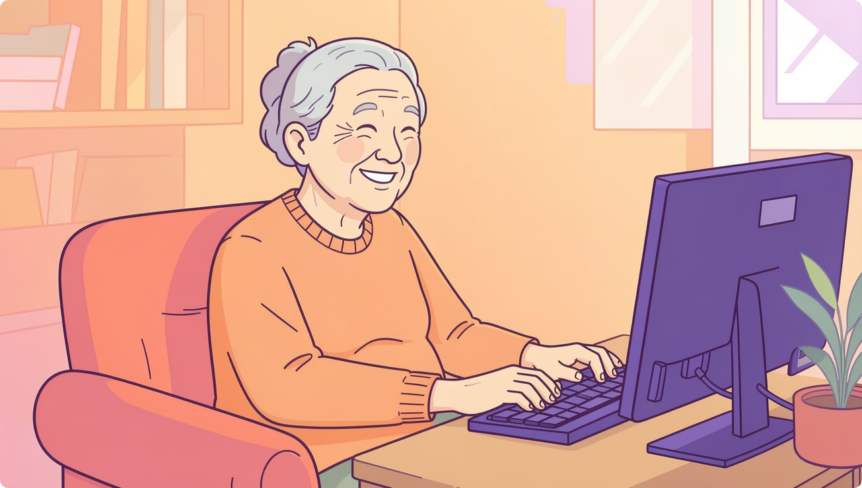
Why This Game Works for Older Adults
The design is built around how adults aged 50 and above learn best — with familiar scenarios, no pressure, and warm encouragement.
Familiar email inbox environment
No time limits or countdowns
Realistic, everyday scam examples
Simple two-button interactions
Notes:
9

Slide 10
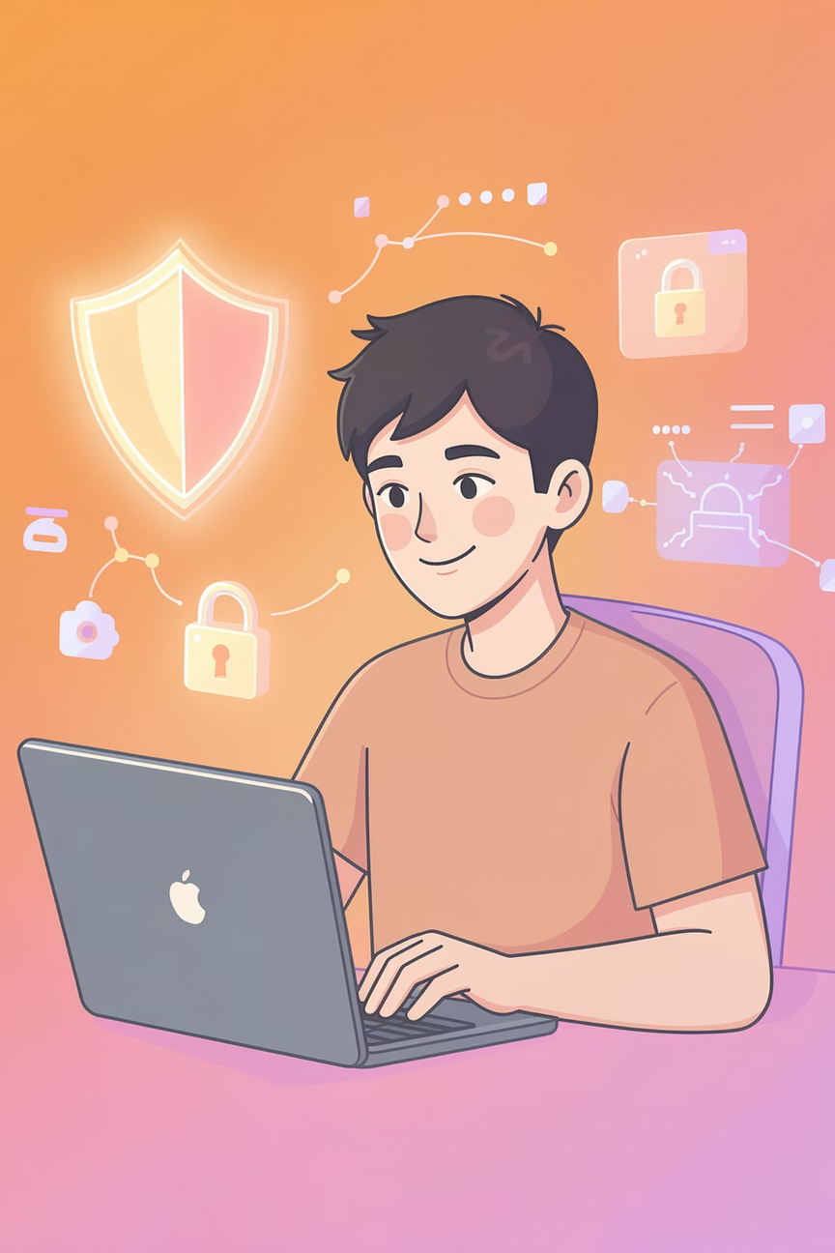

Learn by Doing — Stay Safe for Good
Instead of memorising theory, you learn by observing, deciding, and improving. Every mistake becomes a lesson. Every round builds stronger cyber-safety habits.
🔍 Observe
💡 Decide
Look closely at every email.
Choose safely with confidence.
📈 Improve
Grow safer with every round.
Remember: Check sender addresses, never click unknown links, and ignore urgent threats demanding immediate action. You've got this.
Notes:
10

